Slide 1
Topic:- Web browser

Slide 2
Web Browser
When we need any kind of information most of the time we get help from the Internet, and we get information. The Internet provides us with useful information easily; we use mobile phones, computers, and tablets. We searched for a lot of things in our daily life, so we get information about all over the world, but we cannot get information by just only getting connected to the Internet. We need a platform where we can search for our questions. The platform that provides such kinds of services is called a web browser.
Without a web browser internet will not be able to provide information.

Slide 3
What is a Web Browser?
The web browser is an application software to explore www (World Wide Web). It provides an interface between the server and the client and requests to the server for web documents and services.
It works as a compiler to render HTML which is used to design a webpage. Whenever we search for anything on the internet, the browser loads a web page written in HTML, including text, links, images, and other items such as style sheets and JavaScript functions.
Google Chrome, Microsoft Edge, Mozilla Firefox, and Safari are examples of web browsers.

Slide 4
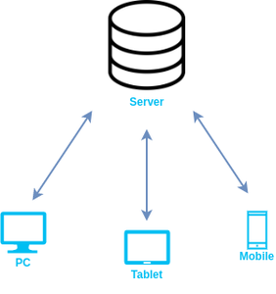
Working of Web Browser
It is installed on the client computer and requests information from the web server such a type of working model is called a client-server model.

Slide 5
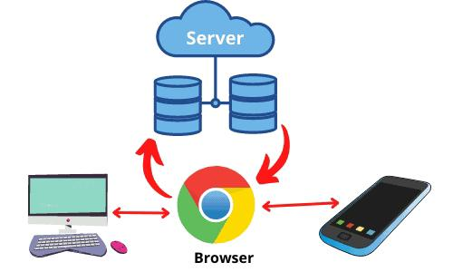

Slide 6
History of the Web Browser
The first web browser WorldWideWeb was invented in the year of 1990 by Tim Berners-Lee.
Later, it becomes Nexus. In the year of 1993, a new browser Mosaic was invented by Mark Andreessen and their team. It was the first browser to display text and images at a time on the device screen.
He also invents another browser Netscape in 1994.
Next year Microsoft launched a web browser Internet Explorer which was already installed in the Windows operating system.

Slide 7
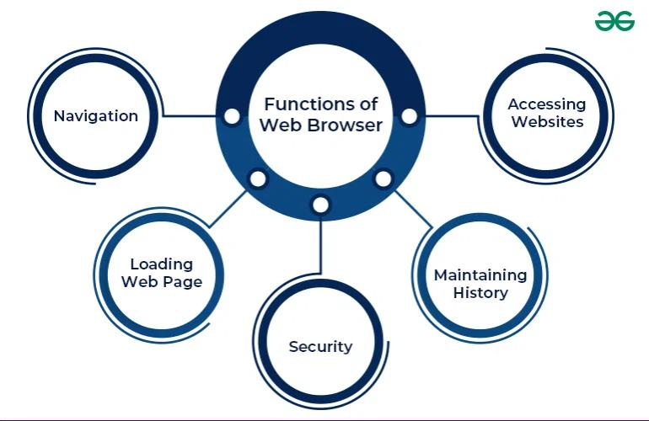
Function of web browser

Slide 8
Some Popular Web Browsers
1. Google Chrome
2. Mozilla Firefox
3. Apple Safari
4. Microsoft Edge
5. Opera

Slide 9
Thank you…. End of the topic…

